Slide 1
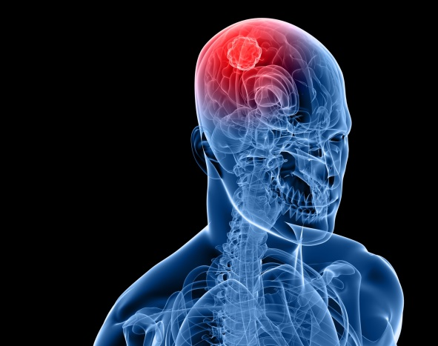
BRAIN TUMOR DETECTION
Presented by : Parker Ho
19 April 2022

Slide 2

Agenda
Bio
Objective
Business Context
Business Question
Data Question
Data Description
Data Visualization
Classification Model
Segmentation Model
Next step
Summary
Data Pipeline

Slide 3
Bio
Education:
Graduate Certificate of Data Science and AI at Institute of Data (UTS)
Master of International Hotel Management at Torrens University Australia
Bachelor of Marketing at University of Economics Ho Chi Minh City
Occupation:
FMCG Supplier Owner
Area Sales Manager (FMCG industry)
Skills:
Deep Learning
Machine Learning
SQL
Data Visualization
Assistant Bar and Restaurant Manager

Slide 4
OBJECTIVE
The goal of this project is to classify and detect Lower Grade Glioma tumor in brain of 110 patients based on MRI image input.
Project including 2 parts:
Identify whether an input image has a tumor.
This is a binary classification problem.
Identify regions of the image that has tumor.
This is a image segmentation problem, where each pixel is labeled as having tumor.
We’re transforming brain tumour diagnosis….

Slide 5
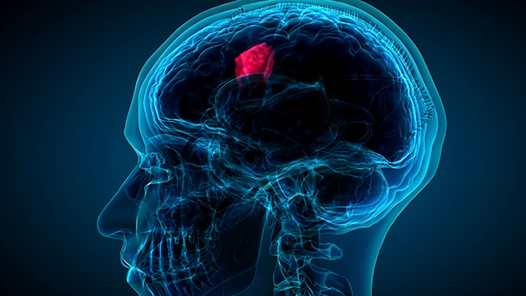
BUSINESS CONTEXT
What is lower-grade glioma brain tumor ?
Early stage of brain cancers
Occurs often in younger adults.
Eventually, most low-grade gliomas will continue to grow and then develop into a higher-grade tumor such as the grade 3 or grade 4 tumors.
It is of vital importance that they can be accurately detected as soon as possible to find a right treatment.
Skilled radiologists reach accuracies of between 92 and 95%. It can take up to 1-2 weeks to get MRI scan results.
In this type of brain tumour with a relatively good prognosis and prolonged survival, the potential benefits of treatment must be carefully weighed against potential treatment-related risks.

Slide 6
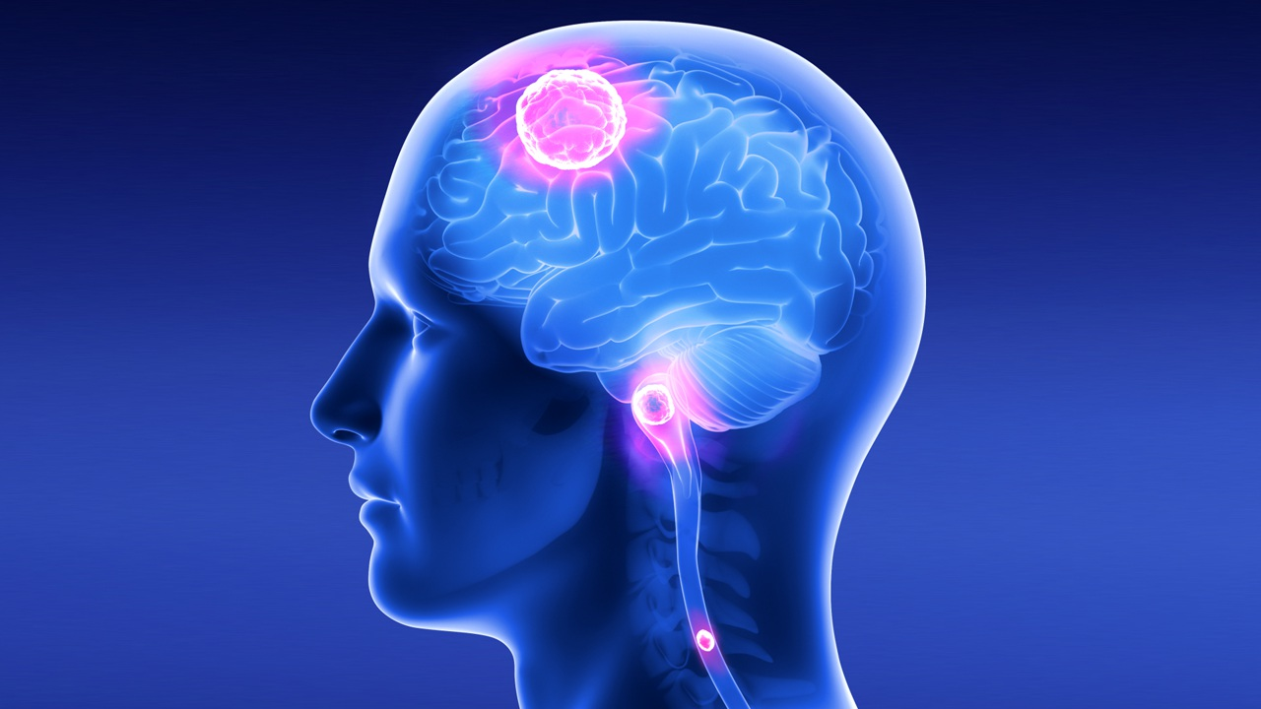
BUSINESS QUESTION
How can we detect tumor more accurately than radiologist and faster?

Slide 7
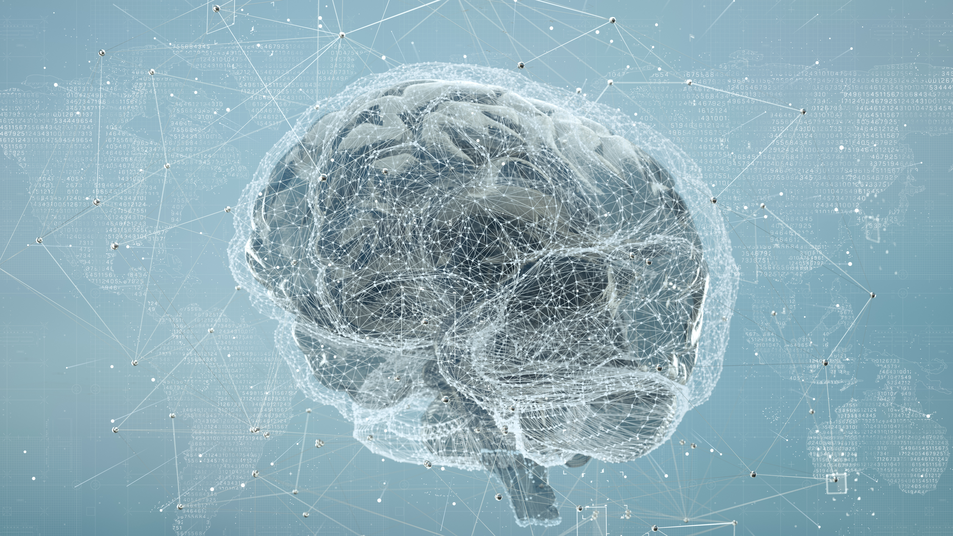
DATA QUESTION
Can we use AI to detect brain tumor based on MRI-scan images?

Slide 8
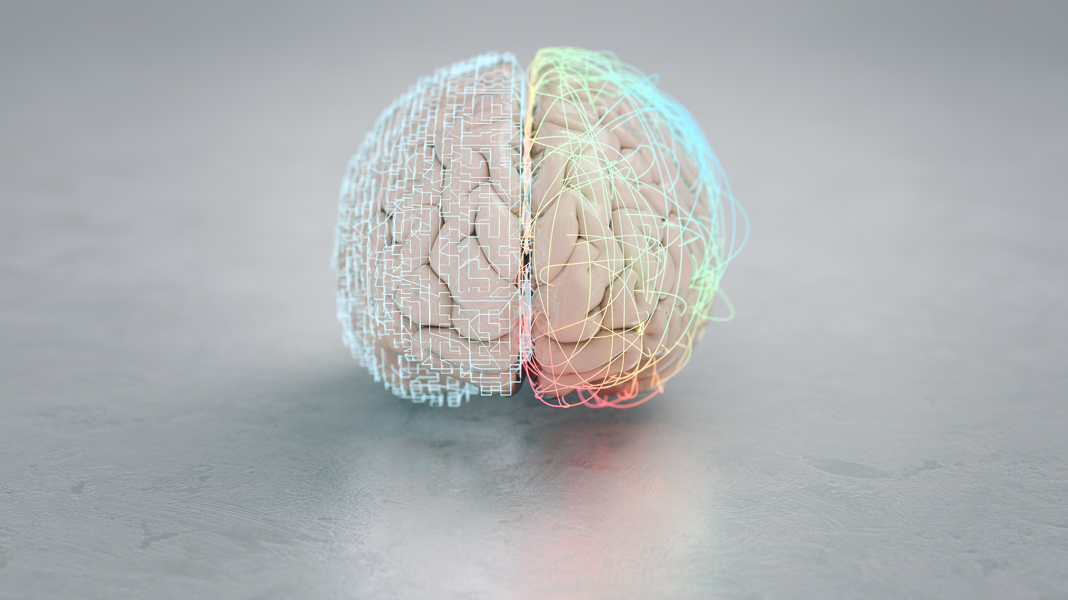
DATA PIPELINE
Radiologist
Business question
Data Question
Data Acquisition
Data Visualization
Classification Modeling
Segmentation Modeling
Answered Data Question
Answered Business Question

Slide 9
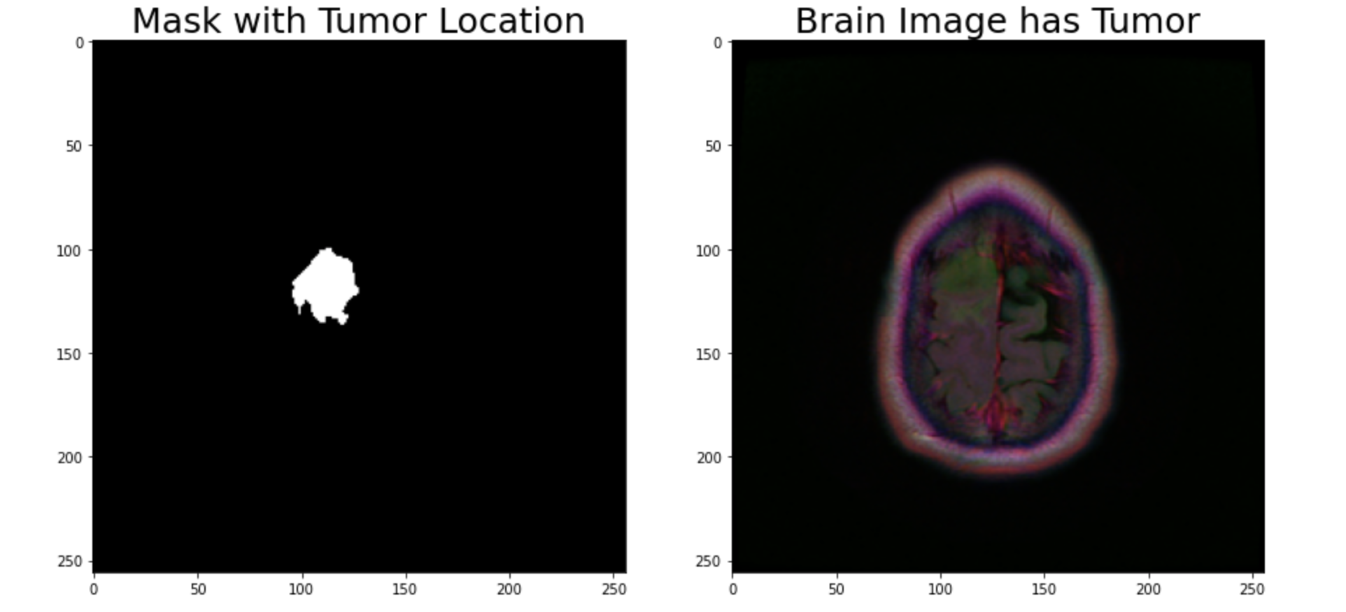
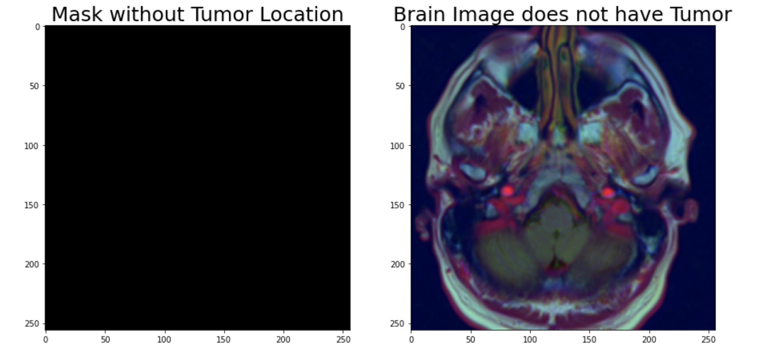
DATASET DESCRIPTION
The dataset's size 1.08GB
CSV file information about 110 patients
Each image is 256x256, tif format
The location of the tumors were given as fluid-attenuated inversion recovery (FLAIR) masks.
The data used comes from 110 patients who had a lower-grade glioma brain tumor from The Cancer Genome Atlas (TCGA).
Source: Kaggle
3,929 images.

Slide 10
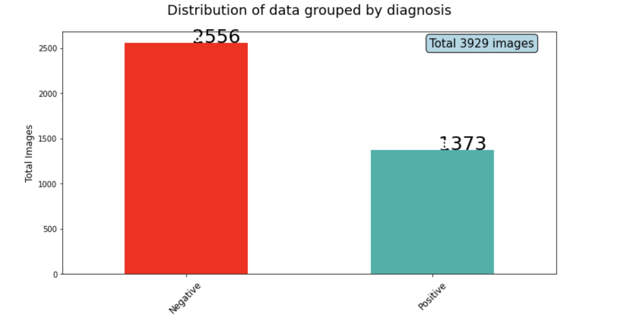
Data Visualization
1,373 images with tumor
2,556 images without tumor
Total: 3,929 images

Slide 11
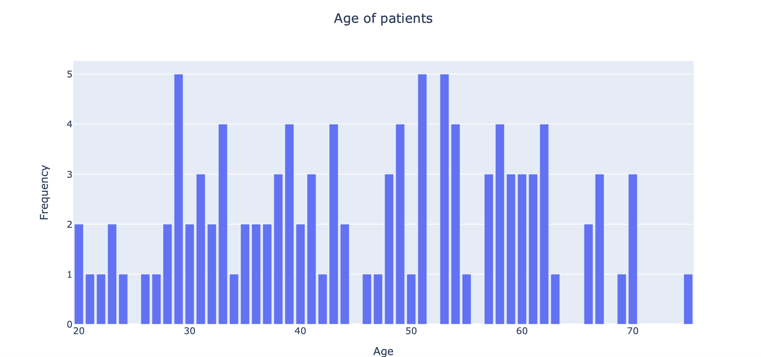
Data Visualization
Most of the patients are between the age of 30 and 60, so lower-grade glioma brain tumors often arise in young adults

Slide 12
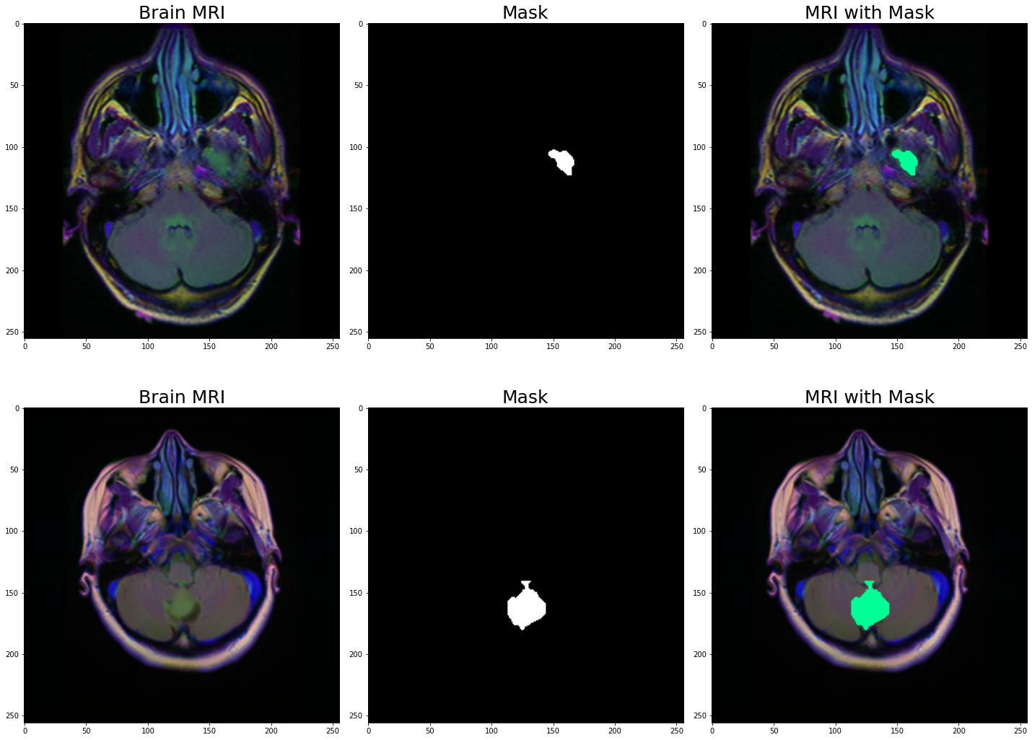
Data Visualization
Images with tumor

Slide 13
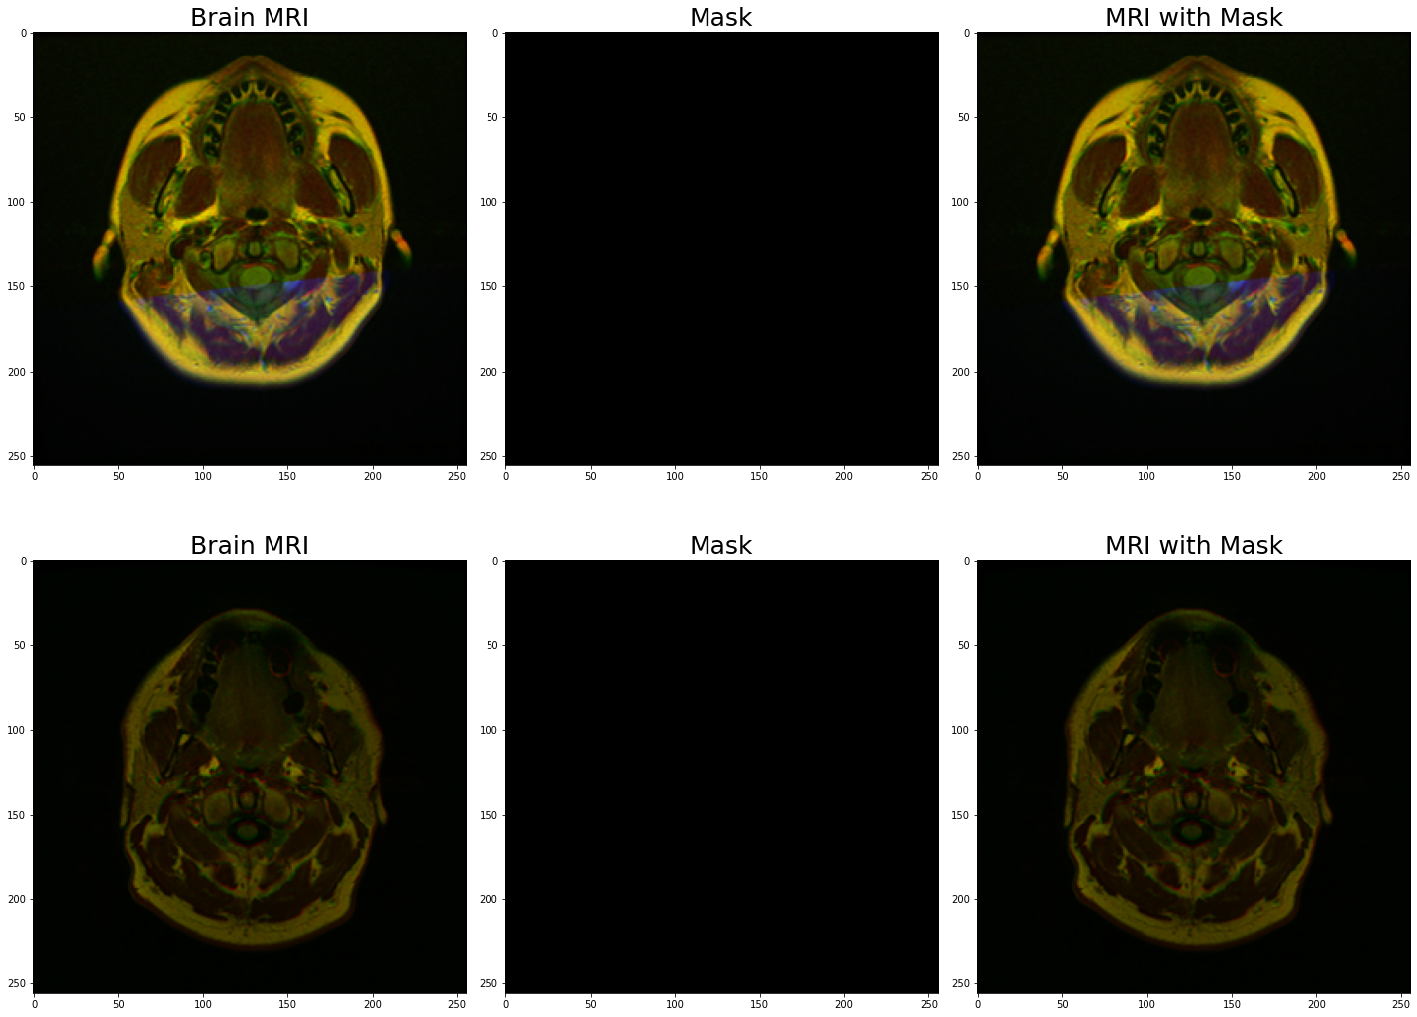
Data Visualization
Images without tumor

Slide 14
Binary Classification - Results
4 images were misclassified; the model predicted tumors despite there being no tumors.)
InceptionNetV2 is best model.
Model | Accuracy | Recall | Precision | AUC | F1-Score
Resnet50 | 0.96 | 0.91 | 0.97 | 1 | 0.94
Resnet50V2 | 0.95 | 0.90 | 0.93 | 0.98 | 0.91
InceptionNetV2 | 0.98 | 0.96 | 0.98 | 0.99 | 0.97
EfficientNetB0 | 0.95 | 0.87 | 0.93 | 0.97 | 0.9
MobileNetV2 | 0.97 | 0.97 | 0.93 | 1 | 0.95

Slide 15
Binary Classification – InceptionNetV2 Performance
F1 Score: 0.97 (lower number of recall and precision as much as possible)
9 images were misclassified, the model predicted no tumors despite there being tumors.
 | No Tumor | Tumor
Predicted No Tumor | 386 | 9
Predicted has Tumor | 4 | 191

Slide 16
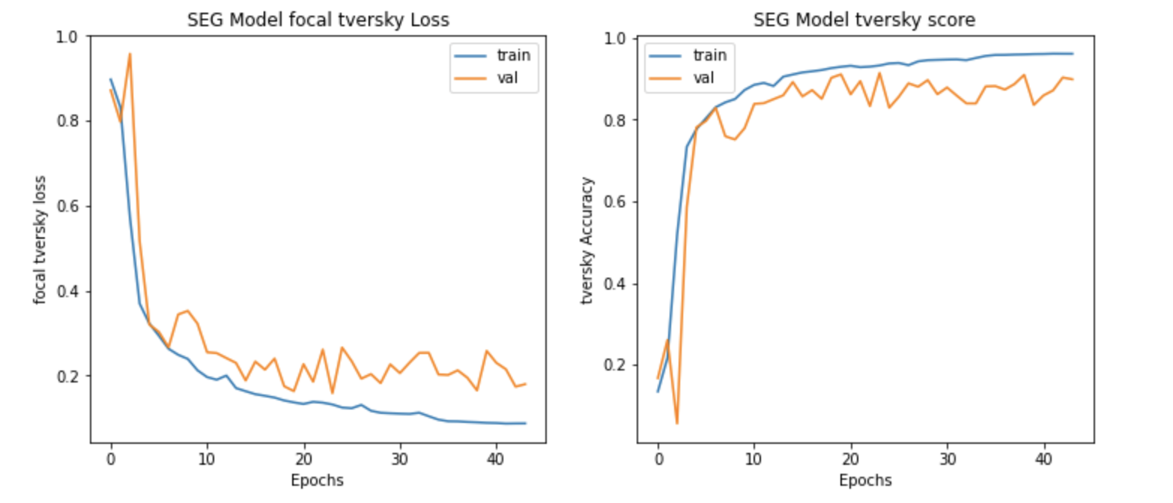
Segmentation Model ResUnet Performance
Tversky Score: 96% (train), 90%(test).
Focal Tversky Loss: 0.08 (train), 0.17(test)

Slide 17
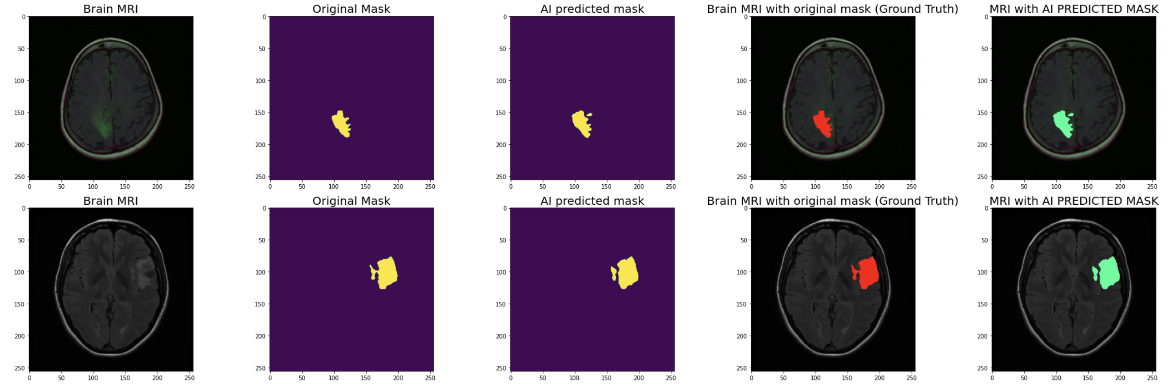
Segmentation Model Result
Original MRI
Annotated ground truth mask on defect region
Overlapping of Original and Ground truth Mask
The predicted mask provided by the segmentation process.
The predicted overlapping.

Slide 18
Next Step
Use
Use difference Segmentation models (YOLO, GANs…)
Collect
Collect more data in order to get more accuracy.
Apply on
Apply on other type of biomedical detection such as: coronavirus, kidney disease, lung cancer…
Adding
Adding more layers to the models trained so far and analyse the performance.

Slide 19
Summary
Patient age is mostly between 30-60 years old.
1
Used 5 classification models and best performance model is InceptionNetV2.
2
InceptionNetV2 Classification model accuracy on unseen data is 98%, F1 score is 97%.
3
ResUnet Segmentation model with Tversky score is 90% on unseen data. Which made the similarity high between ground truth mask and predicted mask.
4

Slide 20
Thank you for your attention!!!
Feedback
Opinion
Question

